Slide 1
Chapter 2-1
How do we represent information in a computer
计算系统概论A
Introduction to Computing Systems
（CS1002A.02）
苗付友
mfy@ustc.edu.cn
2025 Fall
计算机科学与技术学院
School of Computer Science and Technology

Slide 2
Outline
1
How do we represent information in a computer?
2
Integer Data Types
3
2’Complement Integers
4
Binary-Decimal Conversion

Slide 3
Why binary?
Unsigned binary representation
Signed binary representation
Limited length of hardware register
Modular
arithmetic
2’s Complement Integers

Slide 4
Outline
1
How do we represent information in a computer?
2
Integer Data Types
3
2’Complement Integers
4
Binary-Decimal Conversion

Slide 5


A Computer looks like……
PC 电脑
Hardware and Software
3 + 5 = ?
3 > 5 ?
……

Slide 6
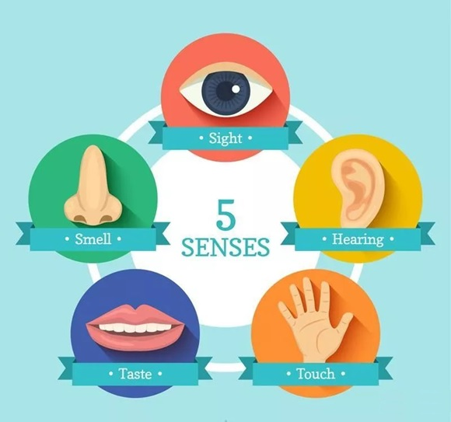
5 Senses of Human
Sight
  Image,picture,photo,video,…
Hearing
  Sound,voice,speech,music,…
Touch
  Shape,soft,hard,hurt,numb,…
Taste
  Sour,sweet,bitter,spicy,salty,…
Smell
  Sweet,smelly,…
to record by number, data, words, symbols, text, language, ……
Notes:
6

Slide 7
What kinds of information needed to represent in computers?
Kinds of Information
  Numbers – natural number, integers, positive/negative integers, integers/decimals, real, complex, rational, irrational, signed, unsigned, floating point, …
  Text – characters, strings, …
  Logical – true, false
  Images – pixels, colors, shapes, …
  Sound – sound of talk, sound of sing, …
  Video – a series of images
  Instructions – plus(+), minus(-), times（*）,divided by(/) , …
  …
Data type: representation and operations within the computer
We’ll start with numbers…
Notes:
7

Slide 8
How do we represent data in a computer?
At the lowest level, a computer is an electronic machine.
  works by controlling the flow of electrons
Easy to recognize two conditions:
  presence of a voltage – we’ll call this state “1”
  absence of a voltage – we’ll call this state “0”
Could base state on value of voltage, but control and detection circuits more complex.
  compare turning on a light switch to measuring or regulating voltage
We’ll see examples of these circuits in the next chapter.

Slide 9
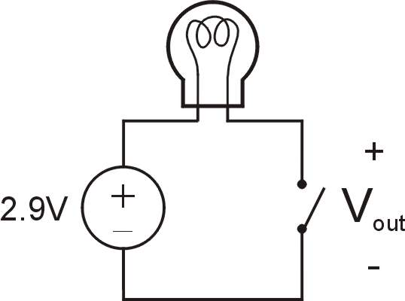
Simple Switch Circuit
Switch open:
  No current through circuit
  Light is off
  V_{out} is +2.9V
Switch closed:
  Short circuit across switch
  Current flows
  Light is on
  V_{out} is 0V
Switch-based circuits can easily represent two states:
on/off, open/closed, voltage/no voltage.
Notes:
9

Slide 10
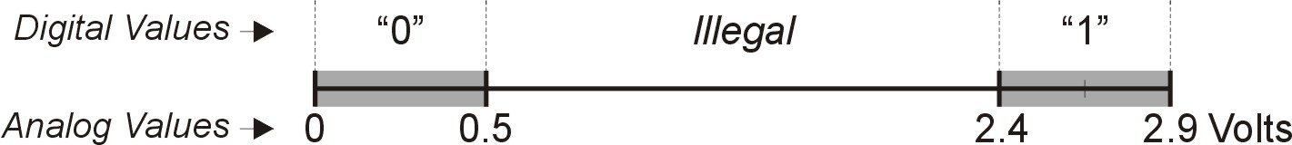
Computer is a binary digital system.
Digital system:
  finite number of symbols
Binary (base two) system:
  has two states: 0 and 1
Basic unit of information is the binary digit, or bit.
Values with more than two states require multiple bits.
  A collection of two bits has four possible states:
  00, 01, 10, 11
  A collection of three bits has eight possible states:
  000, 001, 010, 011, 100, 101, 110, 111
  A collection of n bits has 2^{n} possible states.
Notes:
10

Slide 11

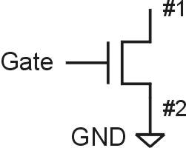
N-type MOS Transistor
MOS = Metal Oxide Semiconductor
  two types: N-type and P-type
N-type
  when Gate has positive voltage,
  short circuit between #1 and #2
  (switch closed)
  when Gate has zero voltage,
  open circuit between #1 and #2
  (switch open)
Gate = 1
Gate = 0
Terminal #2 must be
connected to GND (0V).
Notes:
11

Slide 12
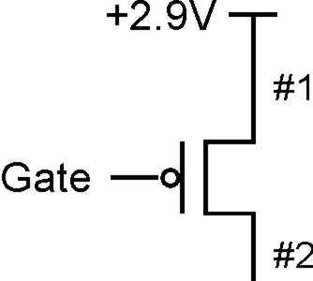
P-type MOS Transistor
P-type is complementary to N-type
  when Gate has positive voltage,
  open circuit between #1 and #2
  (switch open)
  when Gate has zero voltage,
  short circuit between #1 and #2
  (switch closed)
Gate = 1
Gate = 0
Terminal #1 must be
connected to +2.9V.
Notes:
12

Slide 13
Logic Gates
Use switch behavior of MOS transistors to implement logical functions: AND, OR, NOT.
Digital symbols:
  recall that we assign a range of analog voltages to each digital (logic) symbol
  assignment of voltage ranges depends on electrical properties of transistors being used
  typical values for "1": +5V, +3.3V, +2.9V, +1.1V for purposes of illustration, we'll use +2.9V

Slide 14
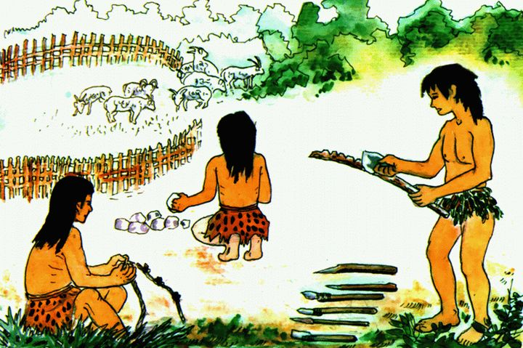
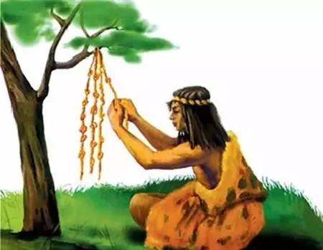
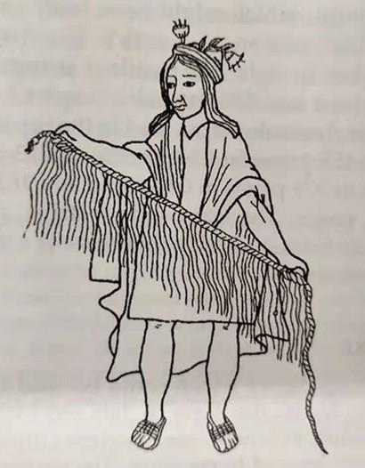
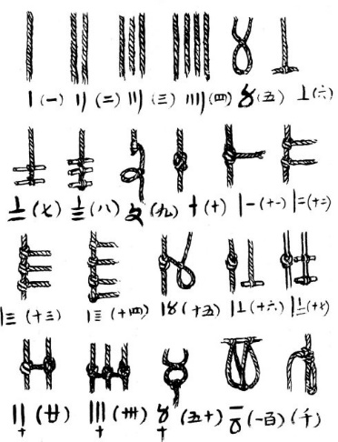
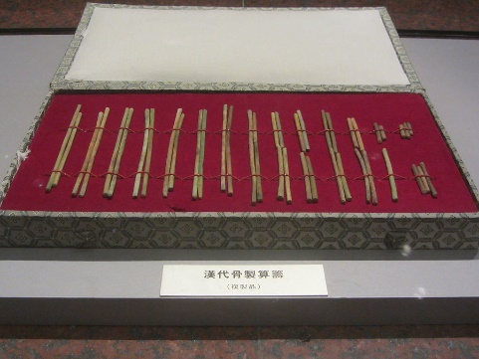
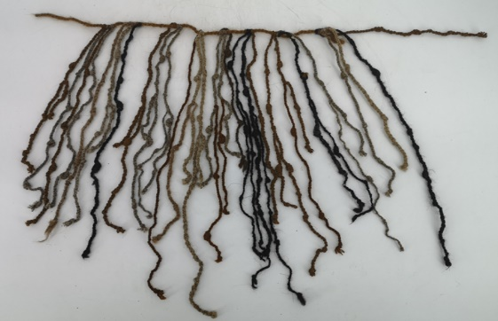
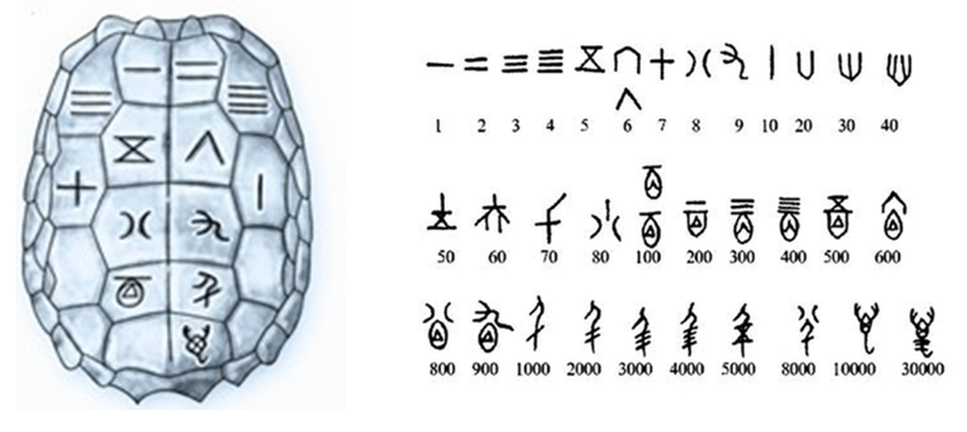
Number Notation
Counting stone(石头）
Knotting(结绳）
Inscriptions on oracle bones
（甲骨文上刻字）
Counting rod(算筹)

Slide 15
Number Notation
Non-positional notation(like to Counting rod)
  Could represent a number (“5”) with a string of ones (“11111”) problems?
5
11111

Slide 16
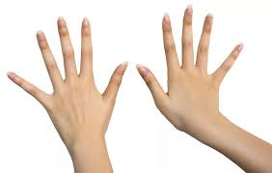

Number Notation
Weighted positional notation
  decimal numbers(denary numbers): “329”
  “3” is worth 300, because of its position(with place value 100),
  while “9” is only worth 9, because of its position(with place value 1)
329
10²
10¹
10⁰
3x100 + 2x10 + 9x1 = 329
Denary numbers
base is 10,
place value according its position

Slide 17
Denary numbers - base ten
(5346)₁₀
5346
Available digit | 0, 1, 2, 3, 4, 5, 6, 7, 8, 9
Place value | 10³=1000 | 10²=100 | 10¹=10 | 10⁰=1
Digit | 5 | 3 | 4 | 6
Product of digit and place value | 5x1000=5000 | 3x100=300 | 4x10=40 | 6x1=6

Slide 18
Octonary numbers - base eight
(5346)₈
  (5346)₈ = 5x512+3x64+4x8+6x1=(2790)₁₀
  (75)₈ = 7x8+5x1=(61)₁₀
  (31276)₈ = 3x4096+1x512+2x64+7x8+6x1=(12990)₁₀
5346
Available digit | 0, 1, 2, 3, 4, 5, 6, 7
Place value | 8³=512 | 8²=64 | 8¹=8 | 8⁰=1
Digit | 5 | 3 | 4 | 6
Product of digit and place value | 5x512 | 3x64 | 4x8 | 6x1

Slide 19
Binary numbers - base two
(101110)₂
  (101110)₂ =1x32+0x16+1x8+1x4+1x2+0x1 =(46)₁₀
  (11110100)₂ = 1x128+1x64+1x32+1x16+0x8+1x4+0x2+0x1=(244)₁₀
  (2790)₁₀ = ( ? )₂
  (5346)₁₀ = ( ? )₂
10 1110
Available digit | 0, 1
Place value | 2⁵=32 | 2⁴=16 | 2³=8 | 2²=4 | 2¹=2 | 2⁰=1
Digit | 1 | 0 | 1 | 1 | 1 | 0
Product of digit and place value | 32 | 0 | 8 | 4 | 2 | 0

Slide 20
Outline
1
How do we represent information in a computer?
2
Integer Data Types
3
2’Complement Integers
4
Binary-Decimal Conversion

Slide 21
Unsigned Integers (cont.)
An n-bit unsigned integer represents 2^{n} values: from 0 to 2^{n}-1.
2² | 2¹ | 2⁰
0 | 0 | 0 | 0
0 | 0 | 1 | 1
0 | 1 | 0 | 2
0 | 1 | 1 | 3
1 | 0 | 0 | 4
1 | 0 | 1 | 5
1 | 1 | 0 | 6
1 | 1 | 1 | 7
Notes:
21

Slide 22
Unsigned Binary Arithmetic
Base-2 addition – just like base-10!
  add from right to left, propagating carry
carry
10010 10010 1111
+ 1001 + 1011 + 1
11011 11101 10000
10111
+ 111
Subtraction, multiplication, division,…
Notes:
22

Slide 23
Signed Integers
With n bits, we have 2^{n} distinct values.
  assign about half to positive integers (1 through 2^{n-1}-1)
  and about half to negative (- (2^{n-1}-1) through -1)
  that leaves two values: one for 0, and one extra
Positive integers
  just like unsigned – zero in Most Significant（MS） bit
  00101 = 5
Negative integers
  sign-magnitude – set top bit to show negative,
  other bits are the same as unsigned
  10101 = -5
  one’s complement – flip every bit to represent negative
  11010 = -5
  in either case, MS bit indicates sign: 0=positive, 1=negative

Slide 24
Three representations of signed integers
Representation | Value Represented
 | Signed Magnitude | 1’s Complement | 2’s Complement
00000 | 0 | 0 | 0
00001 | 1 | 1 | 1
00010 | 2 | 2 | 2
00011 | 3 | 3 | 3
00100 | 4 | 4 | 4
00101 | 5 | 5 | 5
00110 | 6 | 6 | 6
00111 | 7 | 7 | 7
01000 | 8 | 8 | 8
01001 | 9 | 9 | 9
01010 | 10 | 10 | 10
01011 | 11 | 11 | 11
01100 | 12 | 12 | 12
01101 | 13 | 13 | 13
01110 | 14 | 14 | 14
01111 | 15 | 15 | 15
Representation | Value Represented
 | Signed Magnitude | 1’s Complement | 2’s Complement
10000 | ―0 | ―15 | ―16
10001 | ―1 | ―14 | ―15
10010 | ―2 | ―13 | ―14
10011 | ―3 | ―12 | ―13
10100 | ―4 | ―11 | ―12
10101 | ―5 | ―10 | ―11
10110 | ―6 | ―9 | ―10
10111 | ―7 | ―8 | ―9
11000 | ―8 | ―7 | ―8
11001 | ―9 | ―6 | ―7
11010 | ―10 | ―5 | ―6
11011 | ―11 | ―4 | ―5
11100 | ―12 | ―3 | ―4
11101 | ―13 | ―2 | ―3
11110 | ―14 | ―1 | ―2
11111 | ―15 | ―0 | ―1
Signed Magnitude：
5 - 5 = 5 + (-5) =-10
1’s Complement：
5 - 5 = 5 + (-5) =- 0
2’s Complement：
5 - 5 = 5 + (-5) = 0
00101 (5)
+ 10101 (-5)
11010 (-10)
00101 (5)
+ 11010 (-5)
11111 (-0)
00101 (5)
+11011 (-5)
00000 (0)

Slide 25
Outline
1
How do we represent information in a computer?
2
Integer Data Types
3
2’Complement Integers
4
Binary-Decimal Conversion

Slide 26
Modular Arithmetic and Signed Integer Representation
a mod m –the residue of a divided by m
a=q*m+r ; 0<=r<m ; r=a mod m
  Example:14 mod 4=2 due to 14=3*4+2; 2 is the residue of 14 mod 4
  -3 mod 8=5 due to -3=(-1)*8+5;
Registers in a computer have finite length, e.g. length of n bits, or 2^{n} distinct numbers can be represented. Addition, subtraction in a computer is actually modular arithmetic.
For unsigned numbers (模2^{n}运算的截断效果=丢弃n位寄存器的最高进位)
  In decimal (increase by 1, finite representations)
  0 mod 8=0; 1 mod 8=1; 2 mod 8=2; 3 mod 8=3; 4 mod 8=4; 5 mod 8=5;
  000 001 010 011 100 101
  6 mod 8 =6; 7 mod 8=7; 8 mod 8=0; 9 mod 8=1; 10 mod 8=2; …
  110 111 1000 1001 1010
  Example: length of 3 bits-000, 001, 010,011, 100, 101,110, 111
  How to representing -4,-3,-2,-1,0,1,2,3 in 3 bits?
    keep 0,1,2,3 unchanged, how to represent -4,-3,-2,-1 and get arithmetic works?

Slide 27
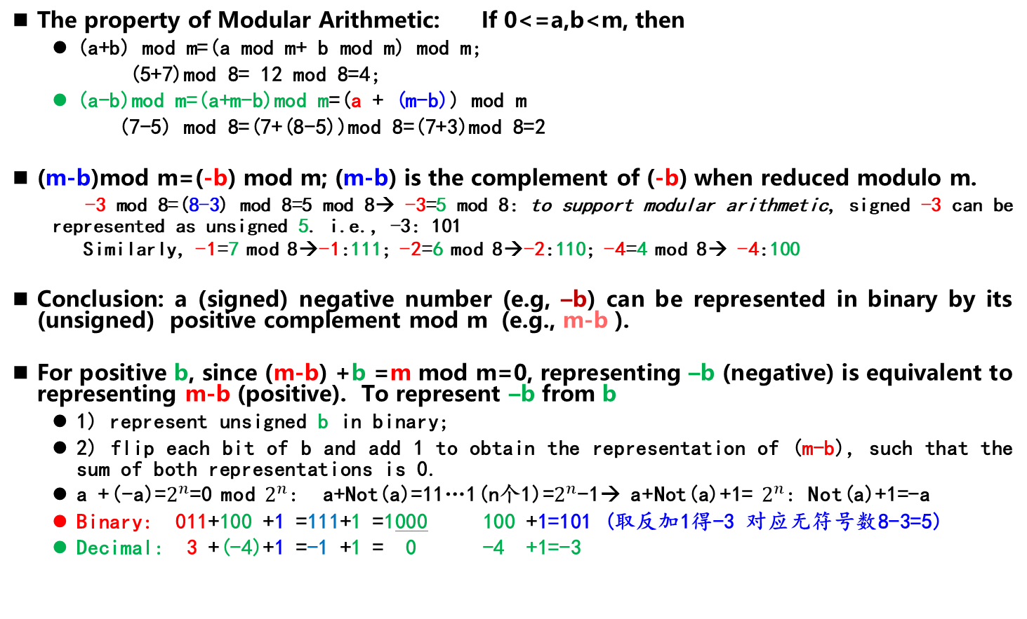
Modular Arithmetic and Signed Integer Representation
The property of Modular Arithmetic: If 0<=a,b<m, then
  (a+b) mod m=(a mod m+ b mod m) mod m;
  (5+7)mod 8= 12 mod 8=4;
  (a-b)mod m=(a+m-b)mod m=(a + (m-b)) mod m
  (7-5) mod 8=(7+(8-5))mod 8=(7+3)mod 8=2
(m-b)mod m=(-b) mod m; (m-b) is the complement of (-b) when reduced modulo m.
  -3 mod 8=(8-3) mod 8=5 mod 8→ -3=5 mod 8: to support modular arithmetic, signed -3 can be represented as unsigned 5. i.e., -3: 101
  Similarly, -1=7 mod 8→-1:111; -2=6 mod 8→-2:110; -4=4 mod 8→ -4:100
Conclusion: a (signed) negative number (e.g, –b) can be represented in binary by its (unsigned) positive complement mod m (e.g., m-b ).
For positive b, since (m-b) +b =m mod m=0, representing –b (negative) is equivalent to representing m-b (positive). To represent –b from b
  1) represent unsigned b in binary;
  2) flip each bit of b and add 1 to obtain the representation of (m-b), such that the sum of both representations is 0.
  a +(-a)=$2^{n}$=0 mod $2^{n}$: a+Not(a)=11…1(n个1)=$2^{n}$-1→ a+Not(a)+1= $2^{n}$: Not(a)+1=-a
  Binary: 011+100 +1 =111+1 =1000 100 +1=101 (取反加1得-3 对应无符号数8-3=5)
  Decimal: 3 +(-4)+1 =-1 +1 = 0 -4 +1=-3

Slide 28
Two’s Complement Representation
If number is positive or zero,
  normal binary representation, zeroes in upper bit(s)
If number is negative,
  start with positive number
  flip every bit (i.e., take the one’s complement)
  then add one
00101 (5) mod 32 01001 (9) mod 32
11010 (1’s comp) 10110 (1’s comp)
+ 1 + 1
11011 (-5) mod 32 10111 (-9) mod 32
(32-5) mod 32=27 (32-9)mod 32=23
Notes:
28
01001 (9)
10110 (1’s c)
+ 1
---------
10111 (-9)
Mathematically, 2^n - M

Slide 29
Two’s Complement
Problems with sign-magnitude and 1’s complement
  two representations of zero (+0 and –0)
  arithmetic circuits are complex
    How to add two sign-magnitude numbers?
      e.g., try 2 + (-3)
    How to add two one’s complement numbers?
      e.g., try 4 + (-3)
Two’s complement representation developed to make circuits easy for arithmetic.
  for each positive number (X), assign value to its negative (-X),such that X + (-X) = 0 with “normal” addition, ignoring carry out
00101 (5) 01001 (9)
+ 11011 (-5) + 10111 (-9)
00000 (0) 00000 (0)
Notes:
29
Sign-magnitude 2 + (-3): convert to subtraction based on sign bit
111
0 010 010
+1 011 - 011
----------- ---------
111
result is really: 2 + (-3) + 8 (or 2^3 for last borrow) = 7
So we have to correct by subtracting from 8: 8 – 7 = 1 is correct magnitude
Hence we need to choose add vs subtract based on sign bit
Then we need to correct magnitude if a final borrow occurred
One’s complement:
If (N>M) result should be positive with magnitude N-M
N + {M} = N + (2^n – 1 – M) = (2^n – 1) + (N – M)
So to get N-M we must subtract (2^n – 1) from result,
i.e. throw out the end-carry (2^n) and add one
(end-around carry correction step)
11 000
0 100
+1 100
----------
10 000
(correction step)
+1
---------
0001
If (M>N), e.g. 3 + (-4), result (M-N)
will be negative; expressed as 1’s
complement what we want is 2^n – 1 – (M – N) = N – M + 2^n – 1
Just as above, this is what we get.
0011
+1011
---------
1110 => this is one’s complement of 1, or -1
Hence no correction step is needed, since there was no final
Borrow.

Slide 30
Two’s Complement Shortcut
To take the two’s complement of a number:
  copy bits from right to left until (and including) the first “1”
  flip remaining bits to the left
011010000 011010000
100101111 (1’s comp)
+ 1
100110000 100110000
(flip)
(copy)
Notes:
30

Slide 31
Two’s Complement Signed Integers
MS(most significant) bit is sign bit.
Range of an n-bit number: -2^{n-1} through 2^{n-1} – 1.
  The most negative number (-2^{n-1}) has no positive counterpart.
-2³ | 2² | 2¹ | 2⁰
0 | 0 | 0 | 0 | 0
0 | 0 | 0 | 1 | 1
0 | 0 | 1 | 0 | 2
0 | 0 | 1 | 1 | 3
0 | 1 | 0 | 0 | 4
0 | 1 | 0 | 1 | 5
0 | 1 | 1 | 0 | 6
0 | 1 | 1 | 1 | 7
-2³ | 2² | 2¹ | 2⁰
1 | 0 | 0 | 0 | -8
1 | 0 | 0 | 1 | -7
1 | 0 | 1 | 0 | -6
1 | 0 | 1 | 1 | -5
1 | 1 | 0 | 0 | -4
1 | 1 | 0 | 1 | -3
1 | 1 | 1 | 0 | -2
1 | 1 | 1 | 1 | -1
Notes:
31

Slide 32
Outline
1
How do we represent information in a computer?
2
Integer Data Types
3
2’Complement Integers
4
Binary-Decimal Conversion

Slide 33
Converting Binary (2’s C) to Decimal
If leading bit is one, take two’s complement to get a positive number.
Add powers of 2 that have “1” in the
corresponding bit positions.
If original number was negative, add a minus sign.
n | 2^{n}
0 | 1
1 | 2
2 | 4
3 | 8
4 | 16
5 | 32
6 | 64
7 | 128
8 | 256
9 | 512
10 | 1024
X = 01101000_{two}
= 2⁶+2⁵+2³ = 64+32+8
= 104_{ten}
Assuming 8-bit 2’s complement numbers.
Notes:
33

Slide 34
More Examples
X = 00100111two
= 2⁵+2²+2¹+2⁰ = 32+4+2+1
= 39ten
n | 2^{n}
0 | 1
1 | 2
2 | 4
3 | 8
4 | 16
5 | 32
6 | 64
7 | 128
8 | 256
9 | 512
10 | 1024
X = 11100110_{two}
-X = 00011010
= 2⁴+2³+2¹ = 16+8+2
= 26_{ten}
X = -26_{ten}
Assuming 8-bit 2’s complement numbers.
Notes:
34

Slide 35
Converting Decimal to Binary (2’s C)
First Method: Division
Divide by two – remainder is least significant bit.
Keep dividing by two until answer is zero,
writing remainders from right to left.
Append a zero as the MS bit;
if original number negative, take two’s complement.
X = 104_{ten} 104/2 = 52 r0 bit 0
52/2 = 26 r0 bit 1
26/2 = 13 r0 bit 2
13/2 = 6 r1 bit 3
6/2 = 3 r0 bit 4
3/2 = 1 r1 bit 5
X = 01101000_{two} 1/2 = 0 r1 bit 6
Notes:
35

Slide 36
Converting Decimal to Binary (2’s C)
Second Method: Subtract Powers of Two
Change to positive decimal number.
Subtract largest power of two
less than or equal to number.
Put a one in the corresponding bit position.
Keep subtracting until result is zero.
Append a zero as MS bit;
if original was negative, take two’s complement.
n | 2^{n}
0 | 1
1 | 2
2 | 4
3 | 8
4 | 16
5 | 32
6 | 64
7 | 128
8 | 256
9 | 512
10 | 1024
X = 104_{ten} 104 - 64 = 40 bit 6
40 - 32 = 8 bit 5
8 - 8 = 0 bit 3
X = 01101000_{two}
Notes:
36

Slide 37
Summary
Everything in a computer is a number, in fact only 0 and 1.
Integers are interpreted by adhering to fixed length
Negative numbers are represented with Two’s complement
Overflows can be detected utilizing the carry bit
We will get into some more representations later when we talk about floating point
Sign Magnitude & Biased representations are needed in floating point for specific uses

